Slide 1

Business Analytics II (BIS 244 – Chapter 7)
Draw Maps
BIS 244 – Fall 2022 – Dr. Davoodi

Slide 2

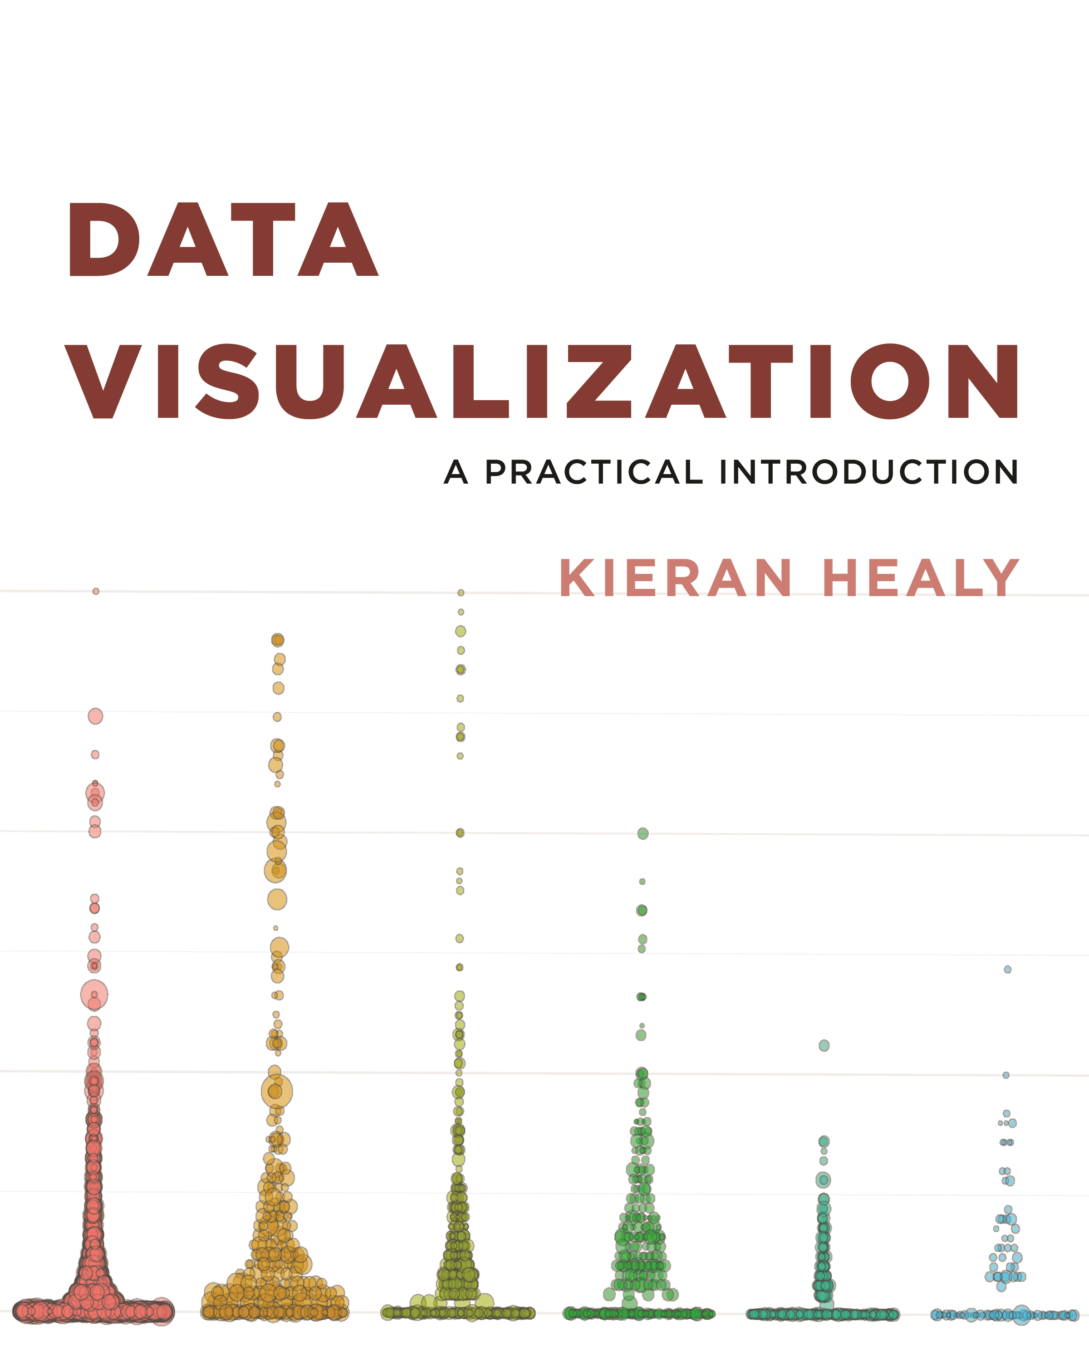
Chapter 7: Draw Maps

Slide 3
Different Maps
Geographical regions on maps are colored, shaded, or graded according to some variable.
First plot is a state-level map where the margin of victory can be high (a darker blue or red) or low (a lighter blue or red).
Second plot is a cartogram, where states are drawn using square tiles, and the number of tiles each state gets is proportional to the number of electoral college votes it has.

Slide 4
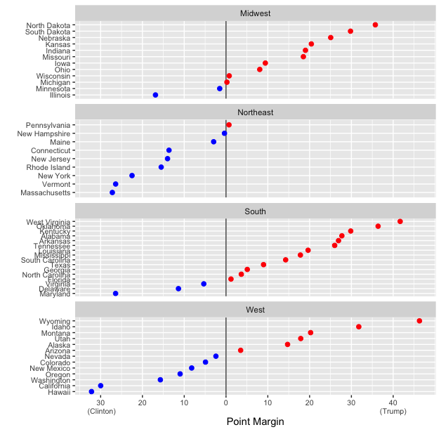
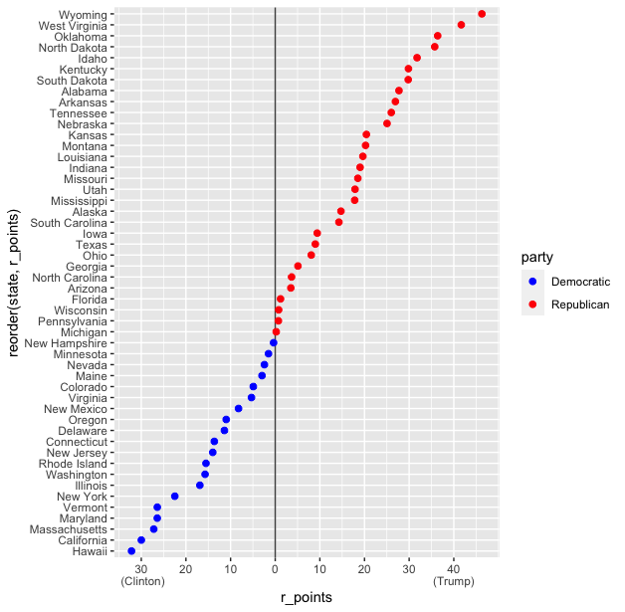
7.1 Map U.S. State-Level Data
Work with the election results

Slide 5
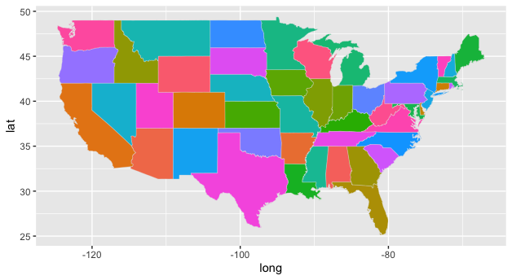
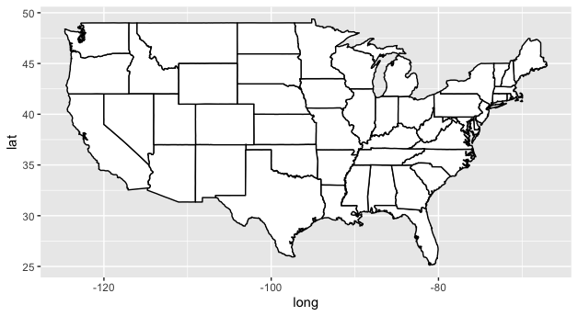
7.1 Map U.S. State-Level Data
Use maps and mapdata packages to create the US map.

Slide 6
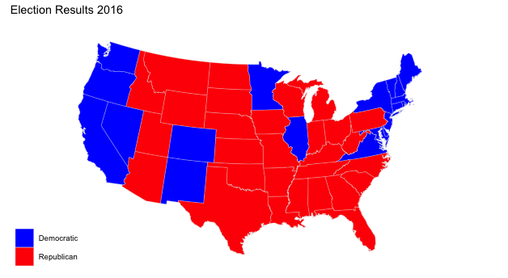
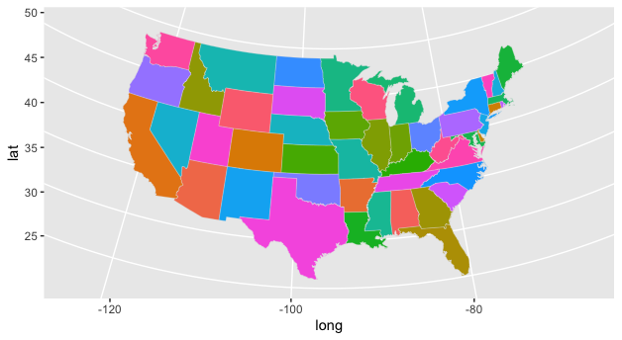
7.1 Map U.S. State-Level Data
The map does not seem in great shape, so we want to improve it.

Slide 7
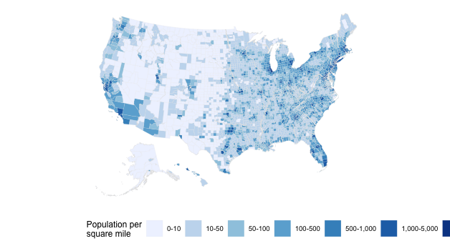
7.2 America's Ur-choropleths
Merging two datasets county_data and county_map
Plot for population density

Slide 8
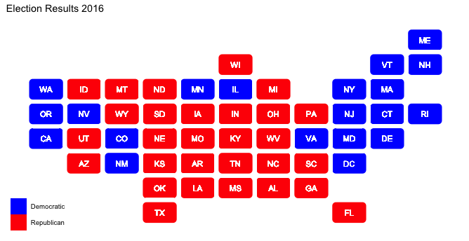
7.3 Statebins
As an alternative to state-level choropleths, we can consider state-bins using a package developed by Bob Rudis.

Slide 9
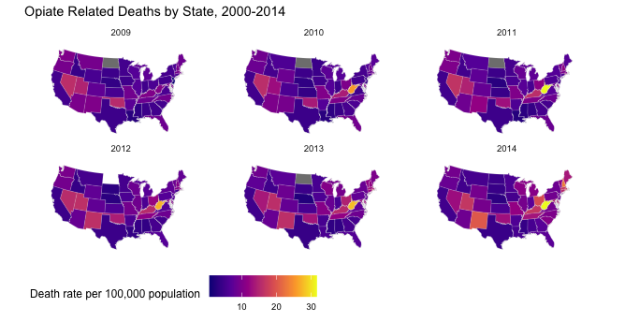
7.4 Small-Multiple Maps
Sometimes we have geographical data with repeated observations over time.
Compare different years

Slide 10
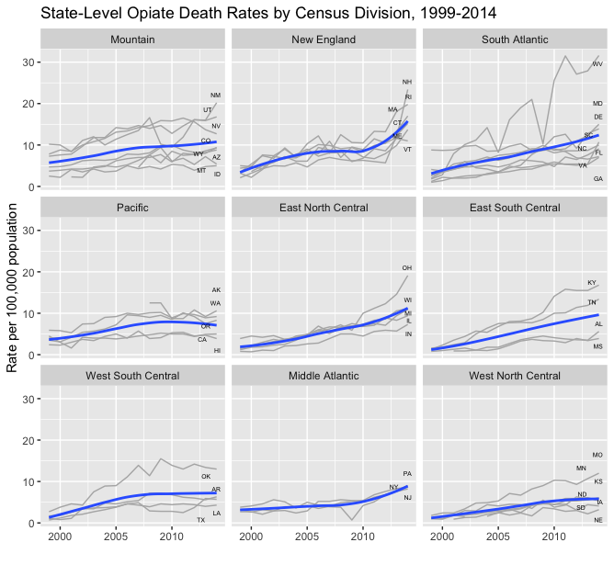
7.5 Is Your Data Really Spatial
even if our data is collected via or grouped into spatial units, it is always worth asking whether a map is the best way to present it.

Slide 11
Summary
In chapter 7, we learned how to
Sometimes is better to use a map to show the results
Packages maps and mapdata are used to create the US map
Instead of map, we may use state-bins
Often is not good to use maps since they are not appropriate.

